Slide 1
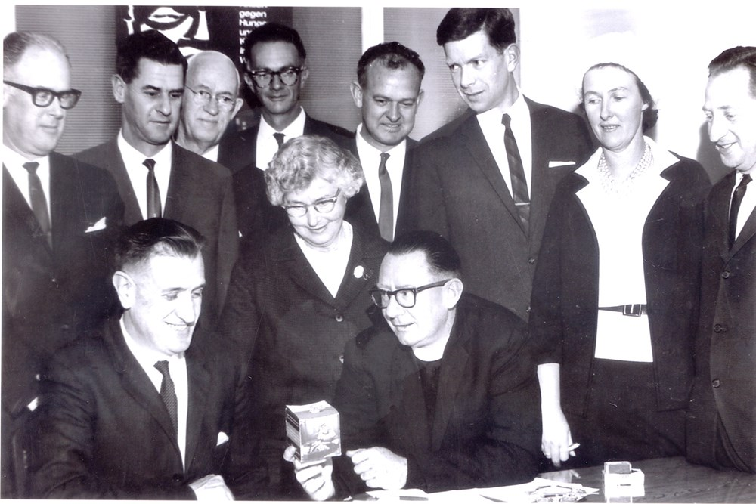

In The
Beginning
Sharing something of the
Beginnings of Caritas in Australia
By Tracey Tessitore

Slide 2
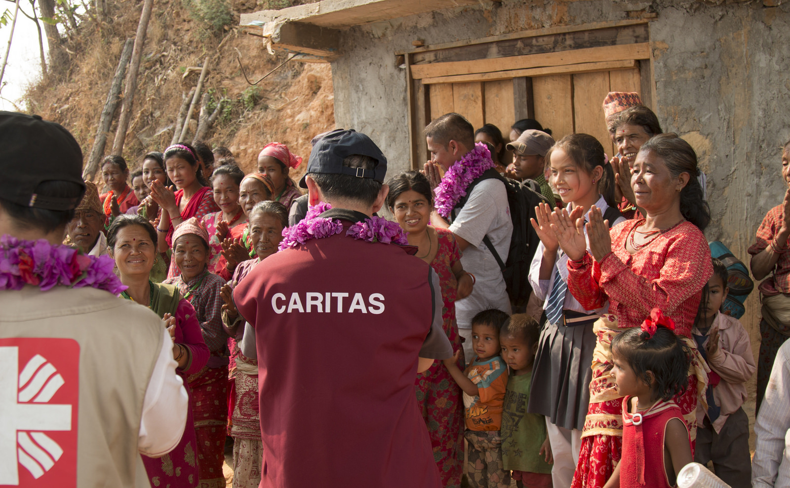
The Beginnings of Caritas Australia
Caritas 1964
Caritas Now

Slide 3
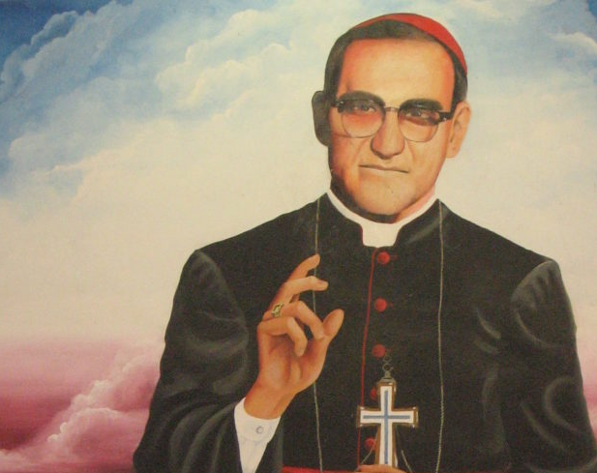
St Oscar Romero
Every human has 3 desires
To be known by name and story
To belong and contribute
To love and be loved

Slide 4
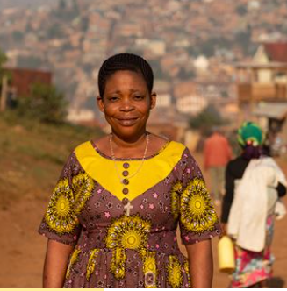
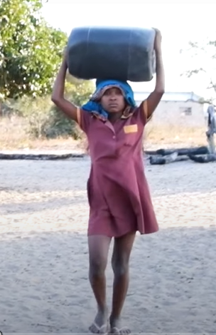
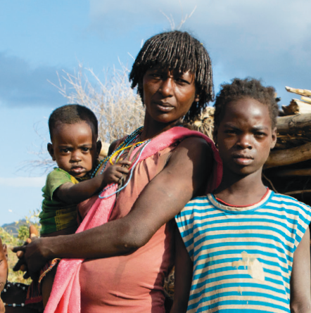
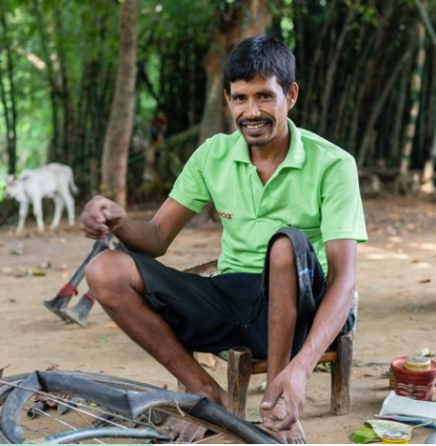
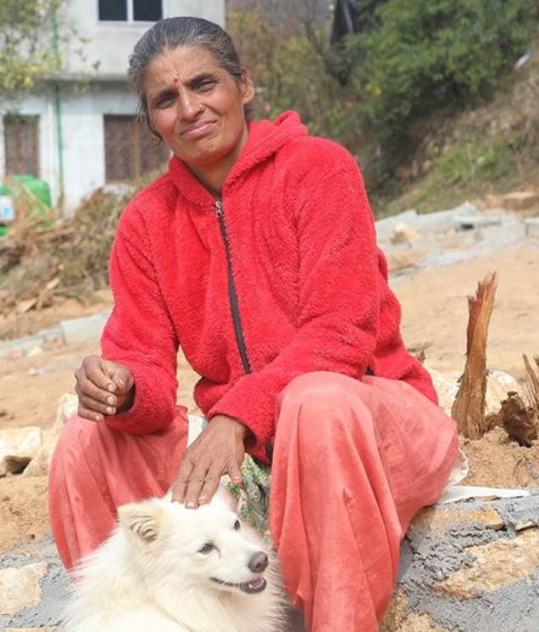
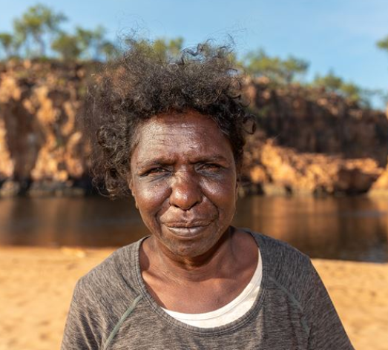
Caritas is known for telling a name and a story
Rosalie
Anatercia
Mali
Biru
Sita
Janice

Slide 5
Jesus Said
I have come not to be served but to serve
(Matt 20:28)

Slide 6
A Name and A Story
David Shinnick

Slide 7
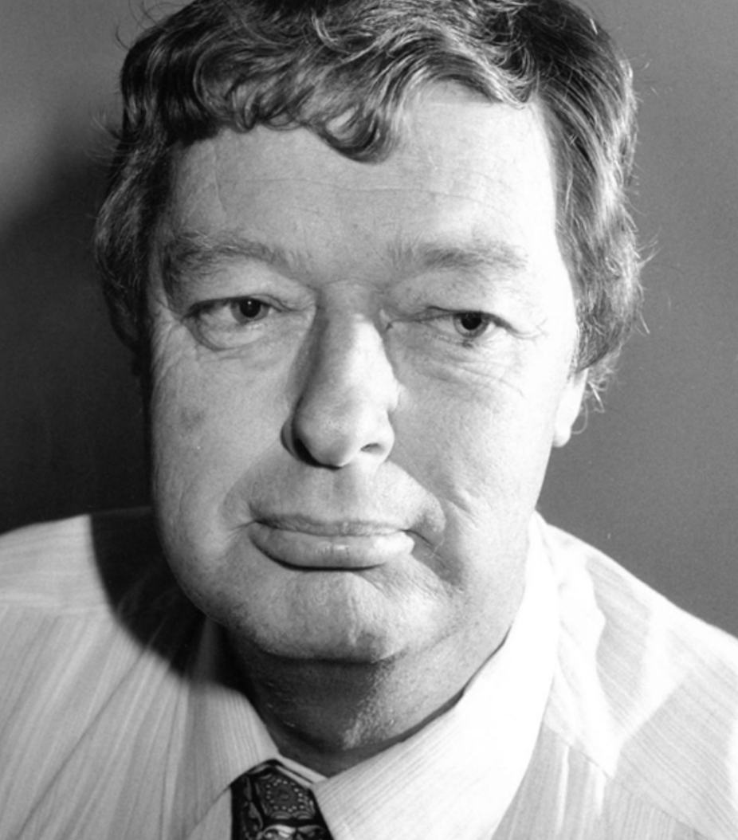

My Name is David Shinnick
This is My Story

Slide 8
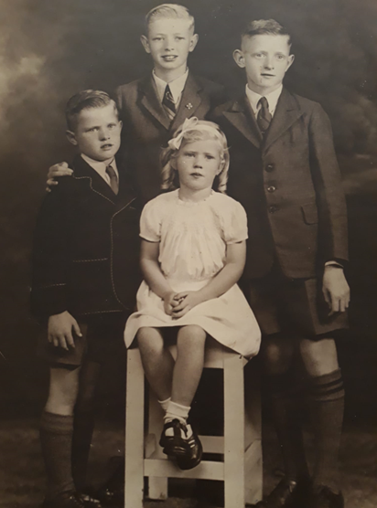
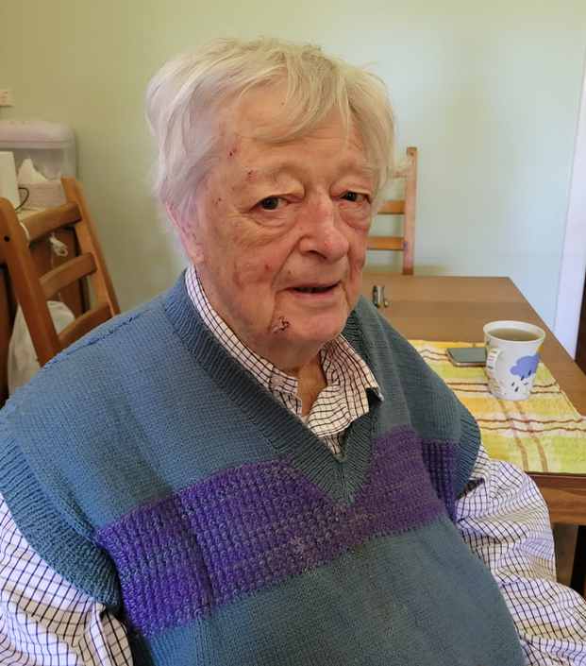
David Shinnick

Slide 9

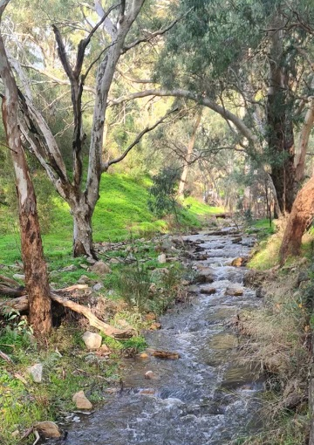
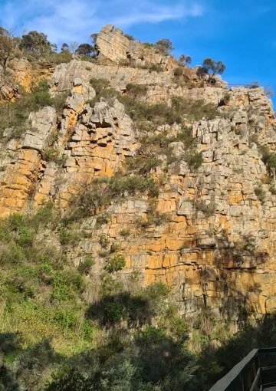
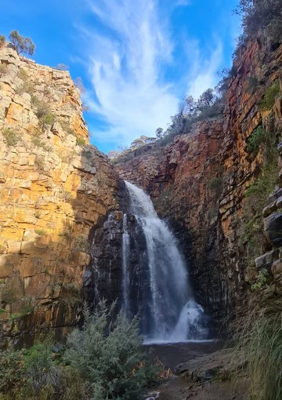
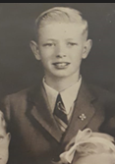
Morialta Falls

Slide 10
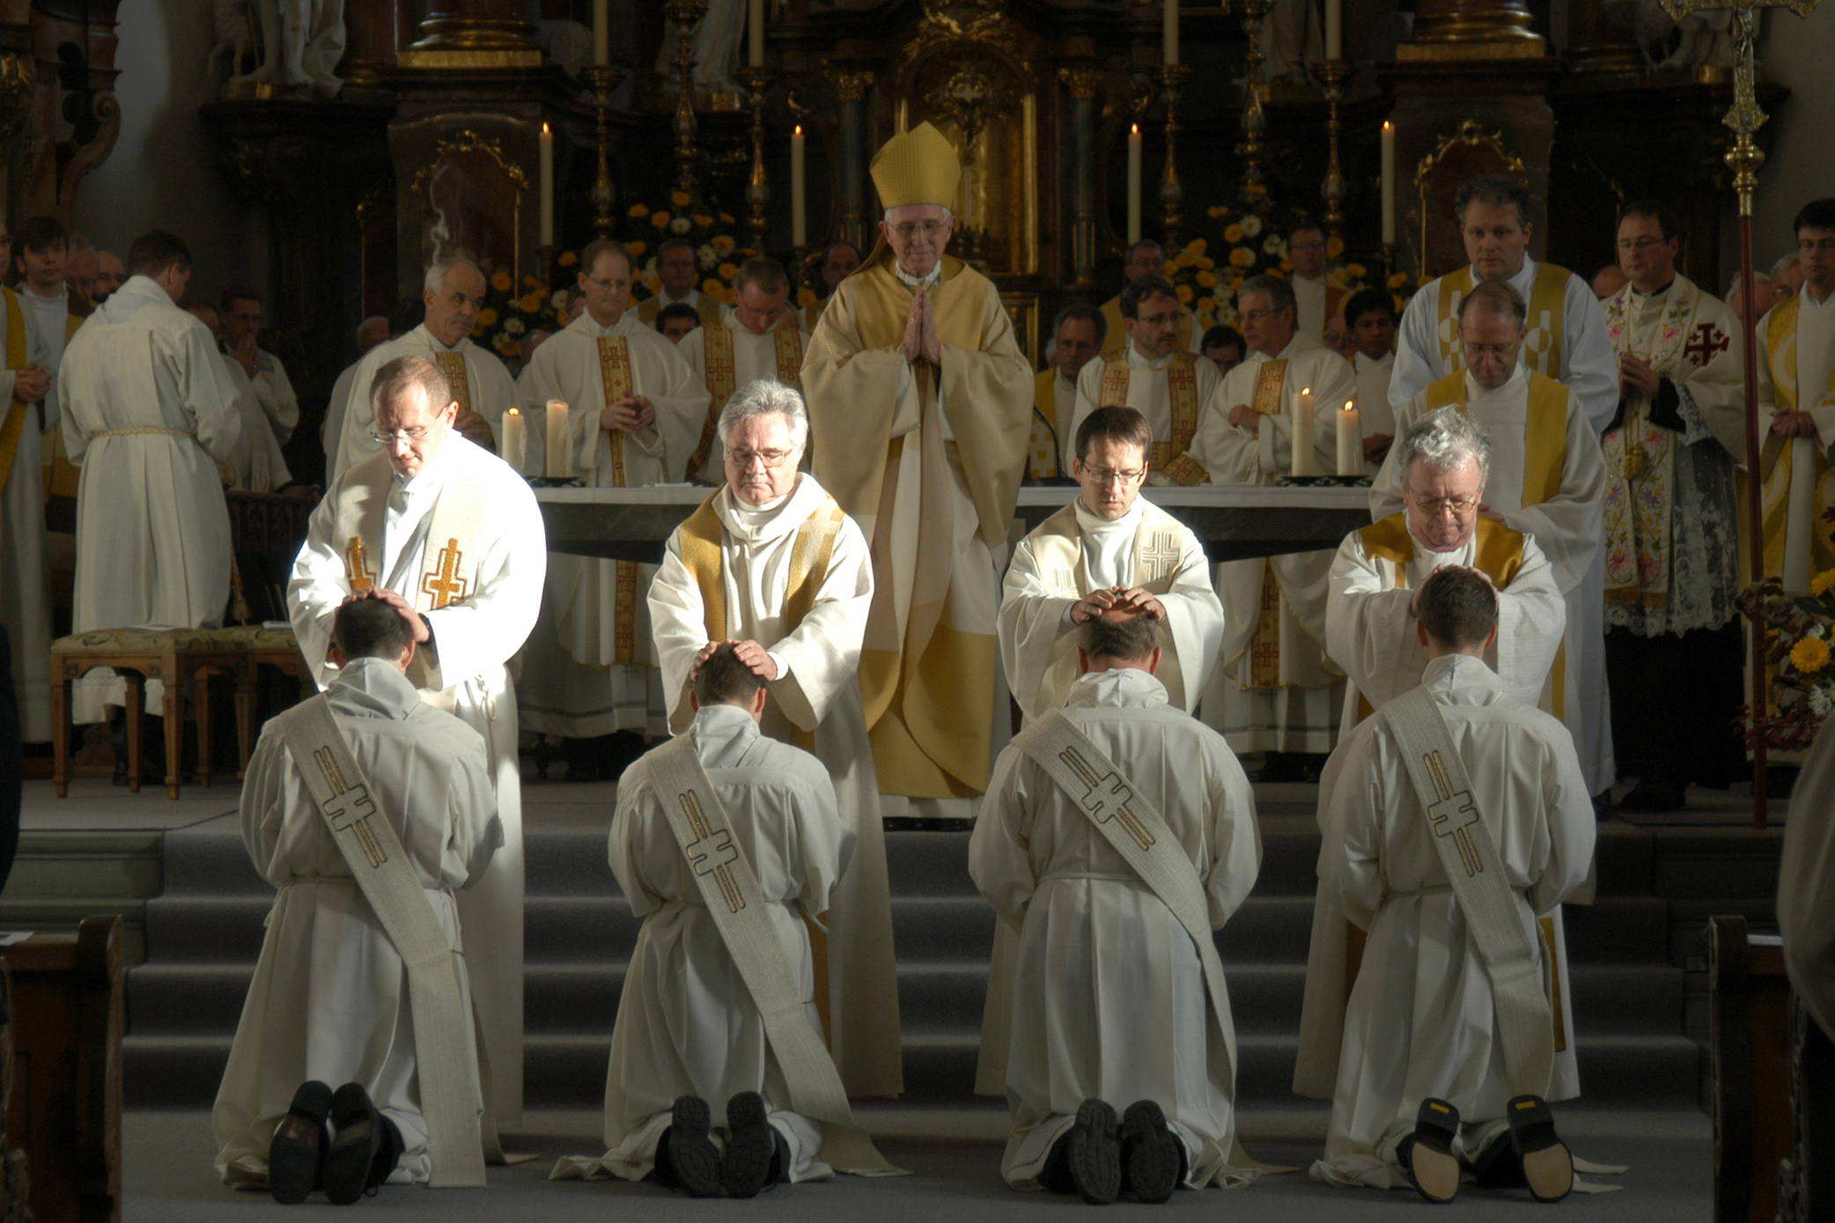
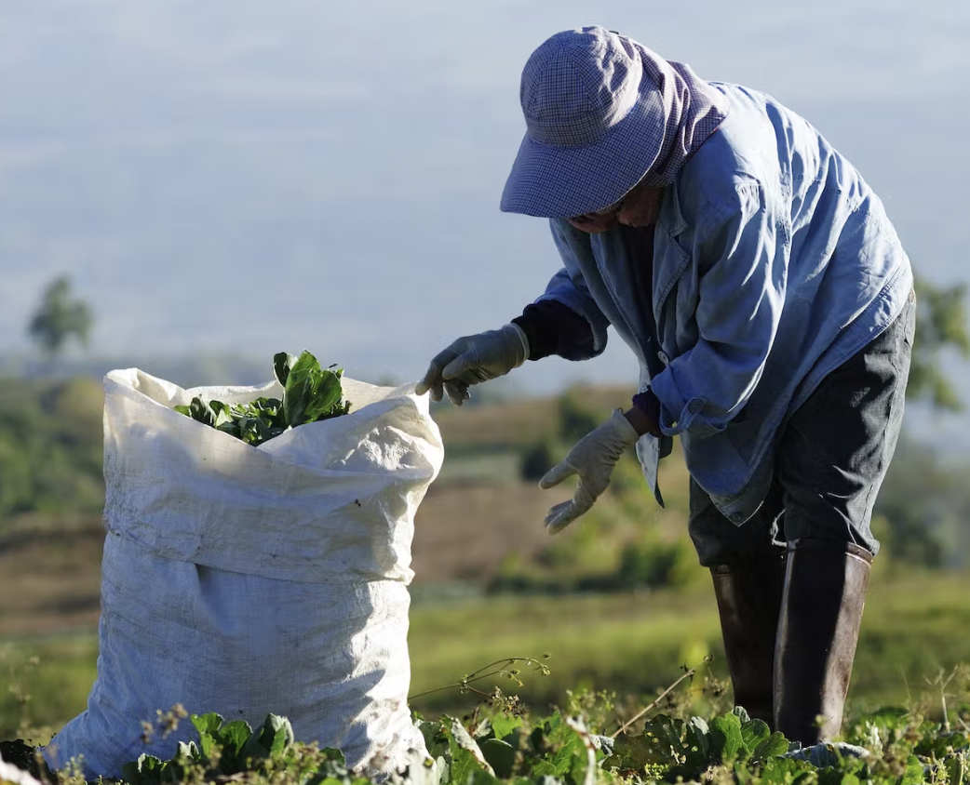

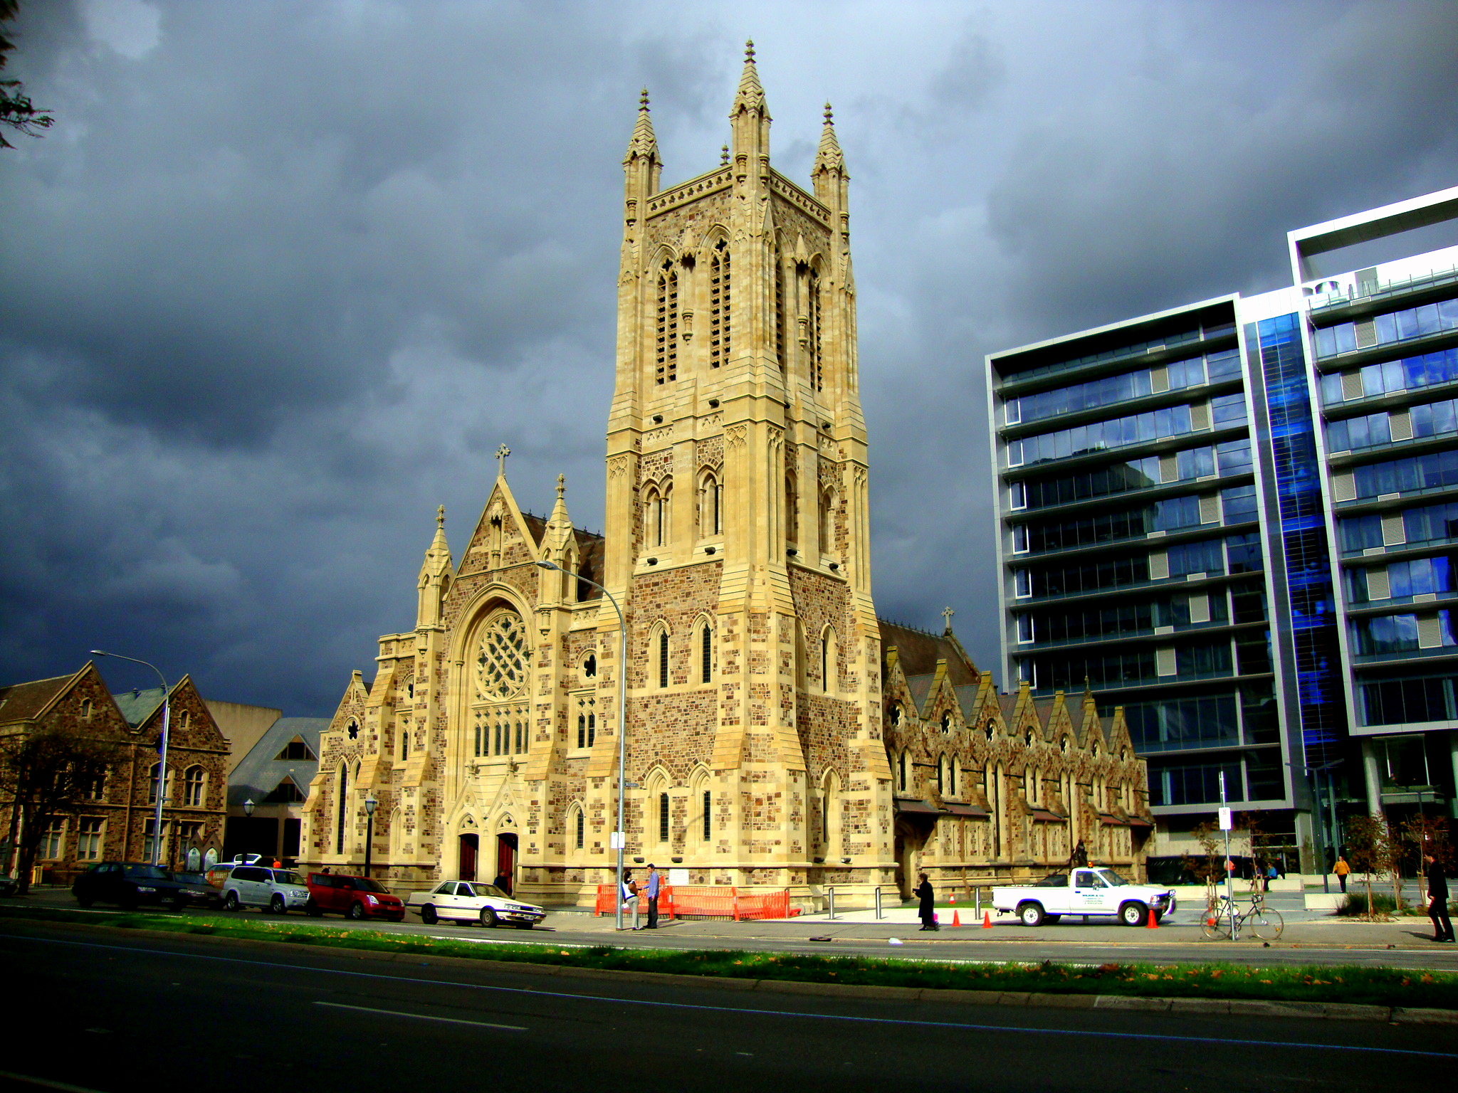

Priesthood
1942-1952
Tram Conductor
1953 - 1954
Farmworker
1952-1953
Catholic Church
1964 - 1995
Administration Work 1954-1955

Slide 11
Question
Why Do I Focus on David?
Answer
David is one of the driving forces of where we are today!

Slide 12
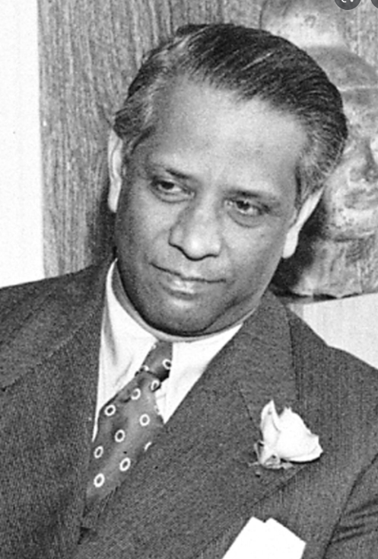

Dr Binay Sen
Director of
United Nations Food &
Agricultural Organisation

Slide 13
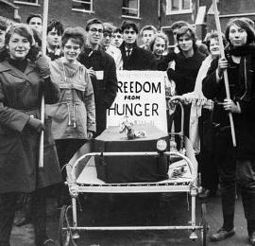
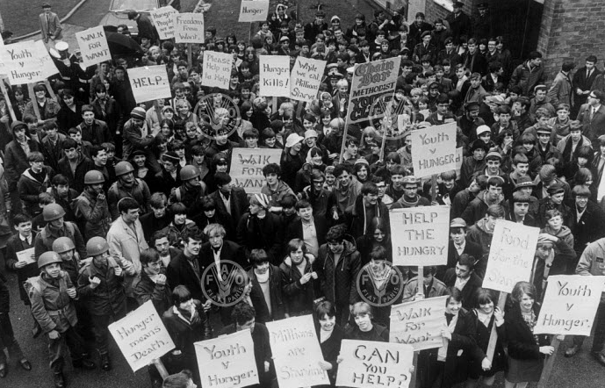
FREEDOM FROM HUNGER CAMPAIGN

Slide 14

The Three Focus During Lent

Slide 15
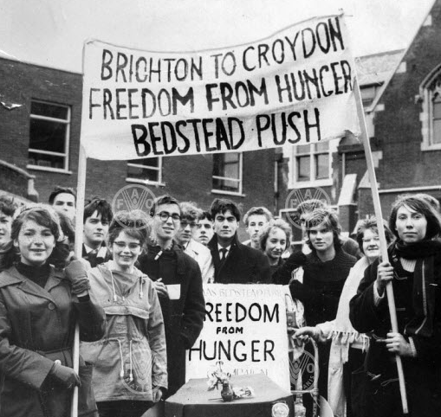
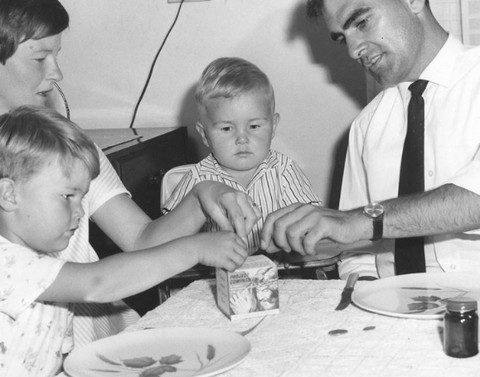
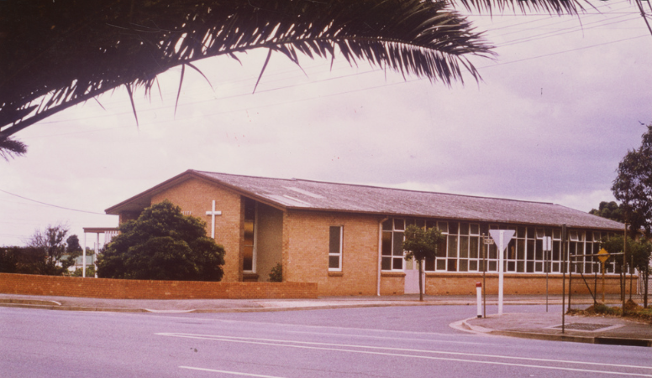



St Mary’s Parish
St Bernadettes Church
For-Runner
to
Project Compassion
Lenten Appeal
with Box
the following year
Hungry Sunday

Slide 16
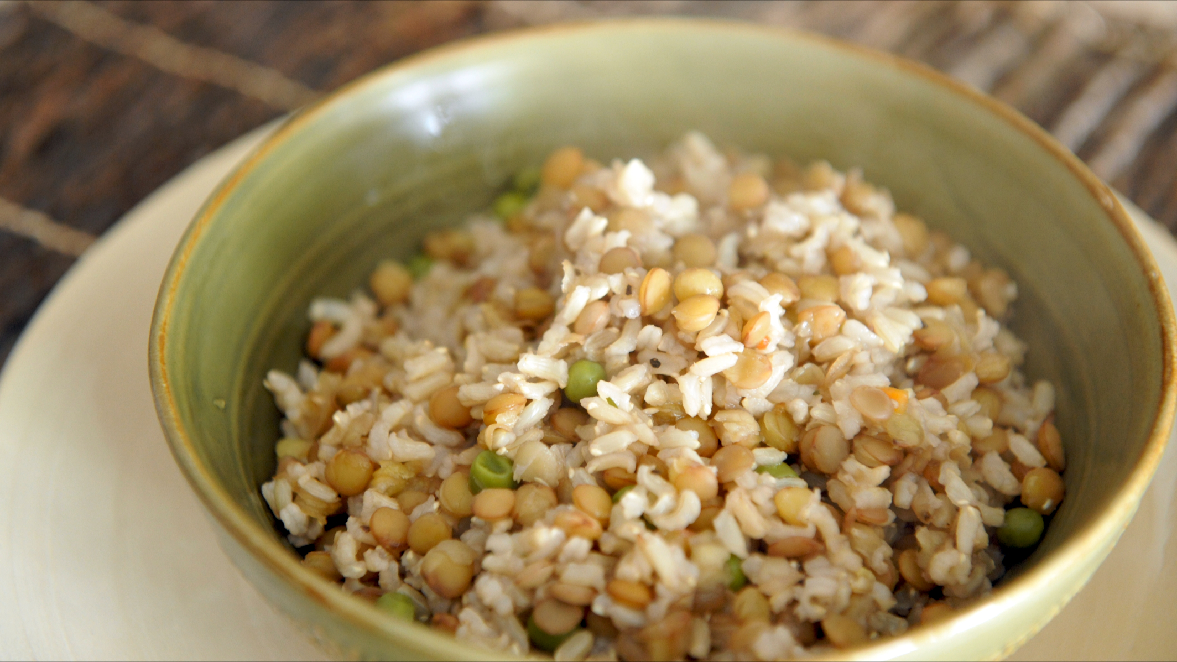

Slide 17
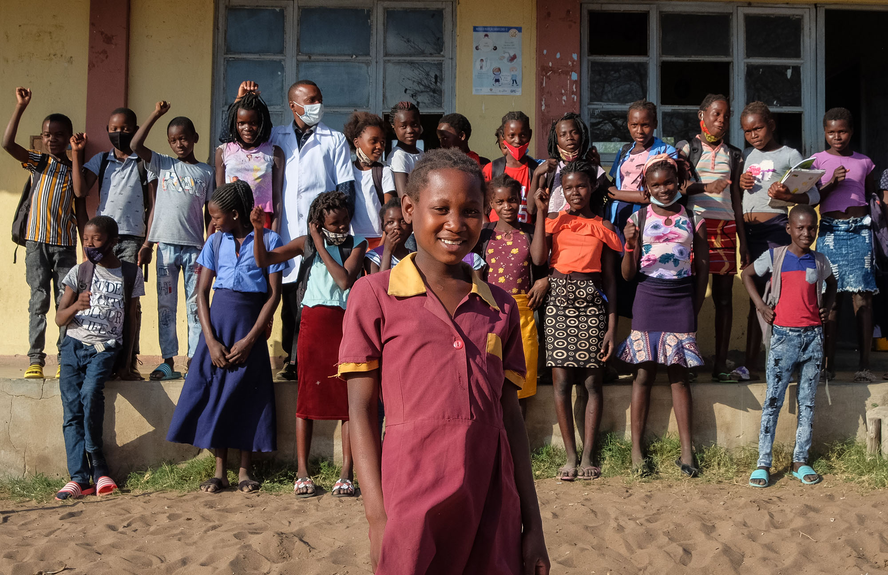
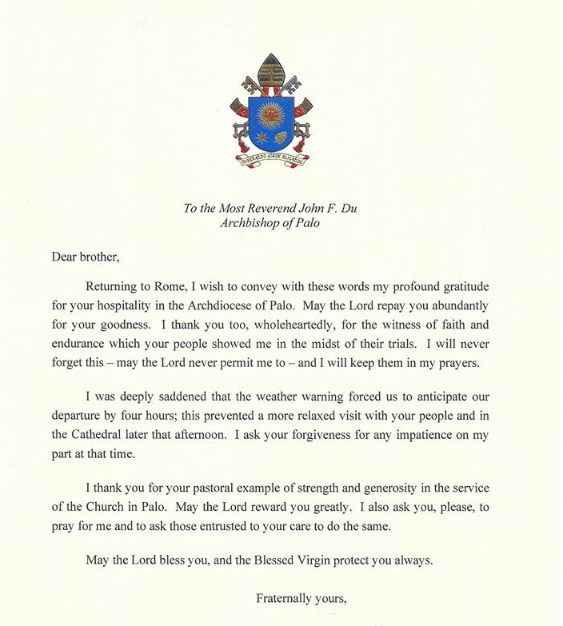

Annual Lenten Appeal
Project Compassion

Slide 18
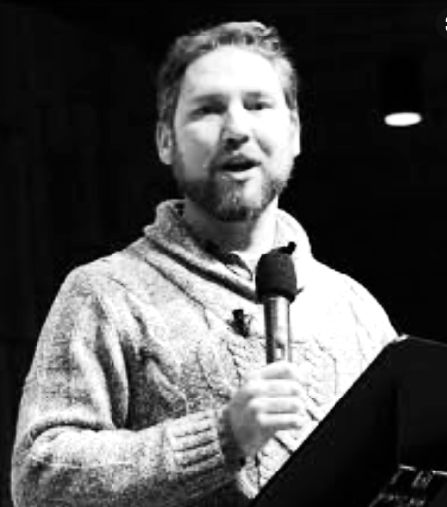
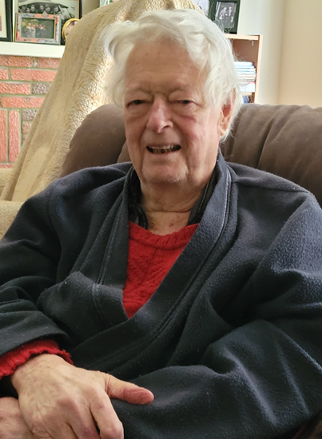
Peter Bierer
Oh David’s finger prints and mark is all over every pastoral planning document of value
and social justice
paper in this building!
He’s an absolute legend!
❝
Assistant Director
for
Pastoral Life and Mission
❞

Slide 19
A Though to Leave On
Why Are You Here?
Who Influenced You?
What are Your Core Values?

Slide 20
David Said
This is where we found our motivation
❞
❝

